Slide 1
2020 General Purpose Grant Application Webinar
Community Development Block Grant Program
Jacquie Andresen
Project Manager
March 2020

Slide 3
Community Development Block Grant (CDBG) – National Perspective
Source: US Dept of Housing & Urban Development (HUD)
Purpose: to benefit low- and moderate-income residents through city and county projects
National budget:
21% decrease from 2010
5% increase from 2019
Special CDBG allocations for federal disaster recovery
Notes:
Show of hands – familiar with CDBG?
Overview of CDBG program
CDBG and coronavirus response

Slide 4
Washington State CDBG
Presentation Resource:
CDBG Fact Sheet
General Purpose Grant Essential Information
CDBG Eligibility Tests
Remember - Application Documents are available at the ZoomGrants Library Tab & CDBG Website

Slide 5
Washington State CDBG
State receives an annual CDBG allocation for rural (non-entitlement) areas
State sets method of distribution
2020 FY = July 20 - June 21
www.commerce.wa.gov\CDBG
CDBG staff listing
State proposes to offer up to four CDBG types of grants:
Economic Opportunity
General Purpose
Housing Enhancement
Public Services
Contingent on approval of 2020 Action Plan
Notes:
www.commerce.wa.gov\CDBG
CDBG staff listing
Action Plan comment period 3/23-4/22, public hearing 4/8

Slide 6
CDBG response to COVID-19
Allowing online CDBG public hearings
Transferring $1 million in available recaptured funds to the more time-flexible Economic Opportunity Grants instead
Sending a future email outlining potential funding plan
Who can apply and what can be funded may be limited to expedite targeted assistance
Extending the CDBG Economic Opportunity Grants into PY 2020
Seeking flexibility on some federal and state compliance requirements.
Notes:
Online public hearings must meet local public hearing requirements

Slide 7
2020 CDBG General Purpose Grant
Annual application cycle
Application opens March 2 and due by June 3
Awards announced early September
Can submit only one General Purpose Grant application per year
unless one is for unrelated local assistance program or planning
NEW ZoomGrants online application portal

Slide 8
2020 General Purpose Grant Application
Total funds available = $11-12 M
Grants (not loans)
No match required
Points for justifying amount requested and leveraged funds
Maximum grant based on project type:
Construction = $900,000 new
Housing rehab program = $500,000
Microenterprise program = $250,000
Planning-only = $30,000 new
And $35,000 limit per household or job benefiting
Notes:
Amount above $11 M dependent on use of CDBG funds to respond to COVID-19 related activities

Slide 9
State CDBG - Who is Eligible to Apply?
Cities/towns < 50,000 (and not in a CDBG urban county)
Counties < 200,000
Complete list and map on CDBG website and ZoomGrants
Subrecipients can be used to implement project with local government oversight
special purpose districts, housing authorities, nonprofit organizations, etc.

Slide 10
State CDBG vs Local CDBG Program Areas

Slide 11
Eligible activities
Planning, acquisition, design and construction
Public infrastructure
Public or nonprofit facilities
In support of select affordable housing or job creation projects

Slide 12
Eligible activities
Local assistance programs
Housing rehabilitation (including utility side services)
Microenterprise assistance
Notes:
Microenterprise assistance could include grants/loans to sustain businesses through impacts

Slide 13
Ineligible activities
Government executive and administrative buildings
Facility operations and maintenance
New housing construction
Activities in a floodway
Activities that can’t comply with federal requirements

Slide 14
CDBG federal requirements
Environmental Review (SEPA/NEPA)
Procurement
Prevailing Wage (Davis-Bacon and related Acts)
Civil Rights
Acquisition and relocation (URA seller/tenant rights)
Financial management and audit (2 CFR 200)
Subrecipient monitoring
Notes:
Environmental – NO choice limiting actions (even with other funds) once CDBG application submitted
Procurement – Consultants (ie engineers) and contracts to be CDBG funded must be procured in compliance with federal and state procurement requirements
Acquisition – Property acquired (even with other funds) for a CDBG-funded project must meet seller and tenant rights requirements
CONSULT CDBG STAFF EARLY

Slide 15
ZoomGrants
Presentation Resource:
Using ZoomGrants to Apply for CDBG General Purpose Grants
ZoomGrants Application Print Preview
Remember - Application Documents are available at the ZoomGrants Library Tab & CDBG Website
Notes:
We are now going to take a look at where and how to get access to our NEW online ZoomGrants Application.
During the next few slides, it will be helpful for you to reference the “Using ZoomGrants to Apply for CDBG General Purpose Grants” and the “ZoomGrants Application Print Preview”.

Slide 16
ZoomGrants Application Link
Go to link on CDBG General Purpose Grant webpage
Open the ZoomGrants CDBG General Purpose Application
At direct link below:
https://zoomgrants.com/gprop.asp?donorid=2142&limited=2585
Notes:
To access the ZoomGrants Application, we recommend using the CHROME internet browser.
Then go to CDBG General Purpose Grant Web page and click on the “APPLY VIA ZOOMGRANTS button”. This will take you directly to the ZoomGrants Application.

Slide 17
ZoomGrants Application at a Glance
Applicant creates account
Applicant assigns collaborators
Follow instructions
Download forms from Library Tab
Complete and upload forms
Fill in ZoomGrants question boxes
Hit Submit Now
Notes:
After you’ve gotten into ZoomGrants, let’s first review how the process works.
Here is when you may want to reference the “Using ZG to Apply for CDGB GP Grants” document. It walks you through the steps providing helpful tips.
Basically you need to get an account, assign collaborators as necessary, and follow the instructions.
Once you are in ZoomGrants, there’s 3 Parts to your Submittal process.
You first review the CDBG Application Resource Material located in the ZoomGrants Library Tab & within each CDBG Application Tab Instructions Button. Next you Answer Questions within each CDBG Application Tab. Lastly you upload applicable documents needed for your submittal.
When you go to Submit, ZoomGrants will let you know if there are required items missing.
Are there questions about the online access or the application process at this point?
Ok – time for a quick break. When we come back, we will start back off by watching a short ZoomGrants video clip.

Slide 18
Notes:
Get Video ready
During Break pull up CDBG GP Website

Slide 19
ZoomGrants Applicant Video
Check out the ZoomGrants Applicant Video
At link below:
https://youtu.be/4vKgUEcl6eA
Notes:
For your viewing pleasure – enjoy this AWESOME ZoomGrants Video ☺
We will be stopping it about 4 minutes - before it gets into the Post Award information. The YouTube Link is shown here & also located on our CDBG GP Web page.

Slide 20
ZoomGrants Navigation
Navigate using TAB Structure:
Level One: Program Information Tabs
Level Two: CDBG Application Tabs
Notes:
As mentioned in the video, ZoomGrants is set up with a 2 Tab Structure.
Level one consists of Administrative Tabs such as: Open Programs, Description, Requirements, Restrictions, Library, and Contact Admin. The Contact Admin Tab sends a direct link to my email.
The Level two tabs are: CDBG Application Tabs. These are used to respond to application questions and are named specific to the General Purpose Program.
The first Tab you see is Applicant Contact Information. This is a mandatory ZoomGrants Tab used to enter basic project, applicant & organization information.
We are not using the “Pre-application function” this cycle in our application.
Here is when you may want to reference the ZoomGrants Application Print Preview document. This gives an “At a glance view” of the CDBG ZoomGrants Application. It starts with next ZoomGrants tab: “Eligibility Summary” and shows the questions through the Your Uploaded Documents Tab.

Slide 21
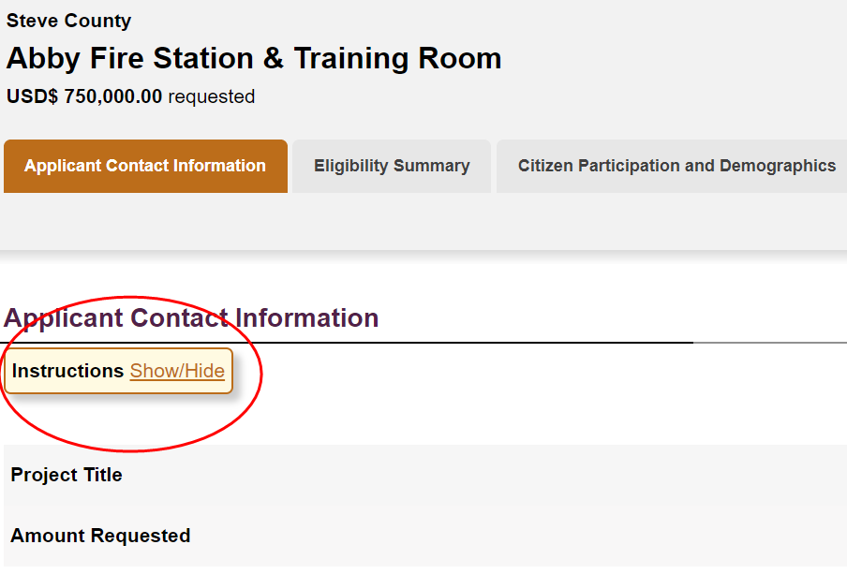
ZoomGrants Instructions
CDBG Application Tabs:
Specific instructions
Notes:
Within each CDBG Application Tab there are specific instructions. These include Links, Guidance, Crosswalk to Tab Questions and Sections.
The “Instructions Button” has a Show/Hide feature. This is helpful to have open when answering questions, but may be nice to hide when in review mode.
Information in the “Instructions Button” may direct you to Guidance Material needed to answer Questions.
In Your Uploaded Documents Tab’s Instructions we’ve included a Visual of REQUIRED DOCUMENTS TO UPLOAD prior to your application Submittal, as well as Examples of how to organize & upload other documents.
Now I’m going to hand over the presentation to Sheila to go over ways to meet your Eligibility.

Slide 22
Applicant Eligibility
Presentation Documents:
Low- and Moderate-Income (LMI) Guide
LMI Benefit Worksheet
ZoomGrants Application Print Preview
Remember -- Application Documents are available in the ZoomGrants Library Tab & CDBG Website
Notes:
Resources for this part of the presentation include the Low- and Moderate-income Guide and LMI Benefit Worksheet.
You may also want to reference the ZoomGrants Application Print Preview document.
Documents are also available in the ZoomGrants Library and on the CDBG Website.

Slide 23
Eligibility Summary Tab LMI Guide and LMI Benefit Worksheet (Q2-Q9)
Low- and moderate-income (LMI)
Up to 80% of area median income
Ex. $51,450 four person family in Adams County
Alternate CDBG national objectives:
Alleviate slum / blight
Address urgent need (emergency)
Application must document how proposed project benefits LMI persons
Guide instructs how to determine LMI benefit and documentations options
Worksheet and supporting documents are uploaded into application
Notes:
Every CDBG-funded activity must document how it benefits low- and moderate-income persons, or in limited circumstances how it meets one of two other alternate national objectives.
The majority of CDBG project’s principally benefit LMI persons. LMI is defined as a persons with a household income no more than 80% of the area median income for their county. For example if you were to look at the CDBG income limits chart, in Adams County it is $51,450 for a family of four.
The Low- and Moderate-Income Guide walks you through the steps you will need to take to determine which benefit category applies to your project; the documentation options for that category; and, how to upload the documents to ZoomGrants. The Worksheet summarizes your determination and will be helpful in transferring your answers to Q2-9 in ZoomGrants.

Slide 24
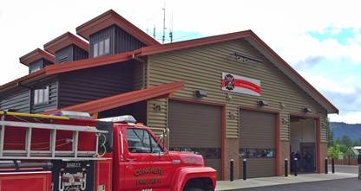
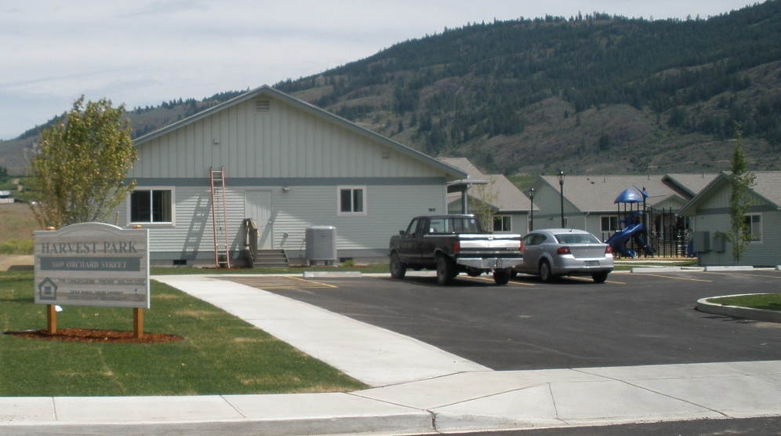
Document benefit to LMI persons
Area benefit activities (pg. 2)
Define service area / pop.
HUD data or
Income survey
Direct benefit activities (pg. 4)
Define target LMI group or
Use income qualification process
Notes:
The first step in documenting benefit to LMI persons is to clearly define who benefits from the proposed project and how. Based on the population to be served, there are two major benefit activities – Area benefit and Direct benefit.
If the project will benefit everyone in a primarily residential area that can be defined by geographic boundaries, then it is providing an area benefit.
For example a fire station improvement. The geographic boundary is defined by a fire district and it serves all residents of the district.
If a project targets services directly to LMI groups or uses income qualification processes to benefit only LMI populations, these projects provide a direct benefit. For example farmworker housing, construction of senior centers, or local assistance programs such a housing rehabilitation programs provide direct benefit.

Slide 25
AREA Benefit LMI Guide pages 2-3
Service area is primarily residential and clearly defined
Project benefits all residents in the service area
At least 51% of residents are LMI
Documentation:
Map of applicant boundaries, service area boundaries, project location
HUD LMI data or income survey of service area
# persons and LMI percentage
Notes:
Area benefit activities are the most common CDBG activity. If your project benefits everyone in a primarily residential area, has geographical defined boundaries, such as a utility system service area or special purpose district, it is eligible for CDBG funding if you can document that at least 51% of the residents are low- or moderate-income.
Applicants must map the service area and determine the total number of persons and households in the service area. CDBG will accept a variety of maps and population data sources. Maps must show the jurisdiction and service area boundaries as well as the project location. Data sources can include OFM Population estimates, 2010 Census population estimates, or the number of households in a utility system or district.
Once you understand who benefits overall, you will need to determine and document number of low- and moderate-income persons that will benefit.

Slide 26
LMI AREA Benefit Data LMI Guide page 3
LMI percentage for each city/town
Use HUD LMI Data List
Service area must match city/town boundaries
LMI percentage for each Census Block Group
Use HUD Interactive Online Map
Income Survey
Use IACC Income Survey Guide or CDBG Income Survey Guide
Notes:
Three ways to document LMI area benefit:
HUD LMI percentages for each city/town. To use HUD’s LMI percentage the service area must match the city/town boundaries.
HUD LMI percentages for each census block group
Conduct an income Survey
We will drill down into each option in the next few slides.

Slide 27
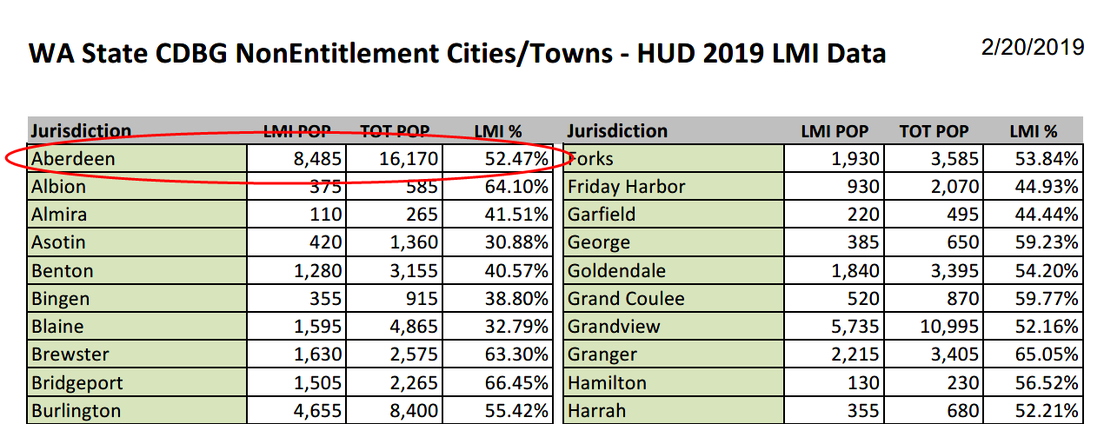
LMI Percentage by City/Town
When the service area = local government boundaries AND
Local government is identified as having 51% or greater LMI population, THEN
Base the project LMI benefit on listed percentage.
Notes:
Option 1 -- HUD provides a list of eligible jurisdictions with their LMI percentages. The is available in the ZoomGrants Library and is also posted on our website under “Technical Assistance Resources”
If the local government’s service area aligns with jurisdiction boundaries and is listed at 51% or greater LMI population, the LMI benefit can be based on the percentage listed. The city of Aberdeen for example could document an LMI benefit of 52.47 percent.
To document the LMI benefit the LG follows the steps in the Guide, completes the LMI Worksheet and follows the documentation instructions by uploading a:
Map showing jurisdiction boundaries and corresponding service area, as well as project location, and
Documentation of city/town population and LMI percentage
If the service area is a portion of or extends beyond the jurisdiction boundaries Or is not listed as LMI
Two options:
HUD LMI/Block Group Data (works in limited cases) OR Income survey

Slide 28
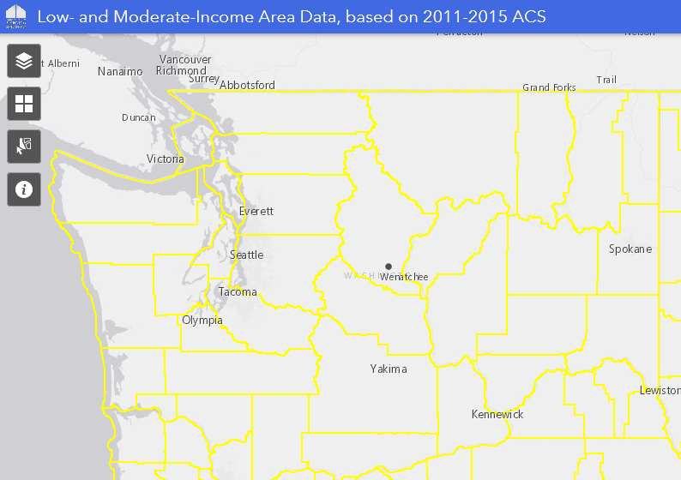
LMI Area Benefit: HUD LMI Block Groups
HUD provides LMI data for each Census block group
https://hud.maps.arcgis.com/home/item.html?id=ffd0597e8af24f88b501b7e7f326bedd
or link is on CDBG website
under Technical Assistance Resources
Contact CDBG staff to discuss this option before applying
Notes:
HUD provides LMI data for every Census block group. Applicants can review Census maps to establish how closely the block group boundaries match the proposed service area boundaries. Maps are available through your planning department or access HUD’s interactive map via the link in the LMI Guide or at the CDBG website.
A note of caution, it can be difficult to document LMI using block group data. Census block groups are geographically large in rural areas, so this data is useful only in limited circumstances. If you plan to use this method, please contact CDBG staff to discuss this option before you apply.
To document submit a map showing which Census blocks you used and how they match the service area. If more than one Census block is involved, you must show how the aggregate LMI percentage is correctly calculated.

Slide 29
LMI Area Benefit: Income Surveys
Two income survey options. Follow:
CDBG Income Survey Guide
Infrastructure Assistance Coordinating Council (IACC) Income Survey Guide
Which guide: Will survey results be used for other funders?
Guides available on CDBG website under Technical Assistance Resources>Guidance Materials>LMI Data Resources.
Survey design and results must be CDBG approved.
Survey must have been conducted since January 2016.
Notes:
If HUD LMI data doesn’t match your service area boundaries or appear accurate you may choose to conduct an Income Survey.
CDBG has its own survey guide and also accepts surveys conducted using the Infrastructure Assistance Coordinating Council Guide.
The IACC guide should be used if applicants are also applying to PWB, DOH, ECY, USDA-RD for this project during this years cycle, or in the future.
Primary differences:
CDBG guide only asks # in household and if household income is above or below CDBG income limit; IACC asks for actual income. An IACC survey must also be conducted by an independent third party
Income Surveys require planning, time and citizen cooperation. Surveys must also be approved by CDBG. And existing CDBG approved surveys must have been conducted since January 2016 and be for the same service area.
If you haven’t already started, they do take time so you will want to consider timing and incorporate it into your work plan to meet the June deadline.
Moving on to Direct Benefit.

Slide 30
DIRECT Benefit LMI Guide pages 4-5
Directly targets services to LMI persons, or
Benefits a limited number or specific group of people as long as at least 51% of those served are LMI persons
Projects can provide direct benefit in the following ways:
Limited Clientele (limit services or facilities to LMI)
Presumed benefit special group
Income qualification
Housing for LMI
Jobs for LMI or microenterprise assistance
Notes:
Direct Benefit activities target services, housing or jobs directly for LMI persons (covered on pages 4-5 of the guide). These activities benefit a limited group or income qualifying persons or households (rather than everyone in a service area). Examples include: homeless shelters, senior center construction, and housing rehabilitation (including private side service connections).
For direct benefit activities to be CDBG eligible, you must be able to document at least 51 percent of persons served or households meet the LMI requirements.
This can be achieved in a number of ways.
Projects can exclusively benefiting a clientele who are presumed by HUD to be principally LMI persons. These presumed benefit groups are listed on page five of the guide. They include: Abused children, elderly persons, severely disabled adults, battered spouses, homeless persons, migrant farmworkers, or persons w/AIDs. Projects examples include construction of senior centers or homeless shelters.
If you have information on family size and income available for the activity that shows at least 51% of clientele meet and will continue to meet LMI income criteria, the data can be used to show a direct benefit. For example: Renovation of a workforce training center.
Or, income eligibility requirements limit activity to LMI persons only. For example: Acquire a building to serve as a new Head Start Center
Housing is another type of DIRECT benefit activity. With this activity applicants collect information on family size, income and occupancy to ensure 100% of assisted households meet the LMI criteria.
Economic development activities such as microenterprise assistance or job creation or retentions can also provide direct benefit by directly assisting small businesses owned by LMI persons, or through creation or retention of LMI jobs. Examples include: establishing a revolving loan fund to provide access to for microenterprise assistance to upgrade necessary equipment for a small business with less than five employees. Or, construction of a public water line necessary for industry expansion or job creation. If you are thinking about economic development activities, we strongly recommend contacting CDBG for guidance given the complexity of our requirements.
Any questions regarding the options for documenting LMI benefit? We’re going to take a 5 minute break before jumping into citizen participation.

Slide 31
Citizen Participation and Demographics
Presentation Resource:
Citizen Participation Guide
Ethnicity and Race Instructions
ZoomGrants Application Print Preview
Remember - Application Documents are available at the ZoomGrants Library Tab & CDBG Website

Slide 32
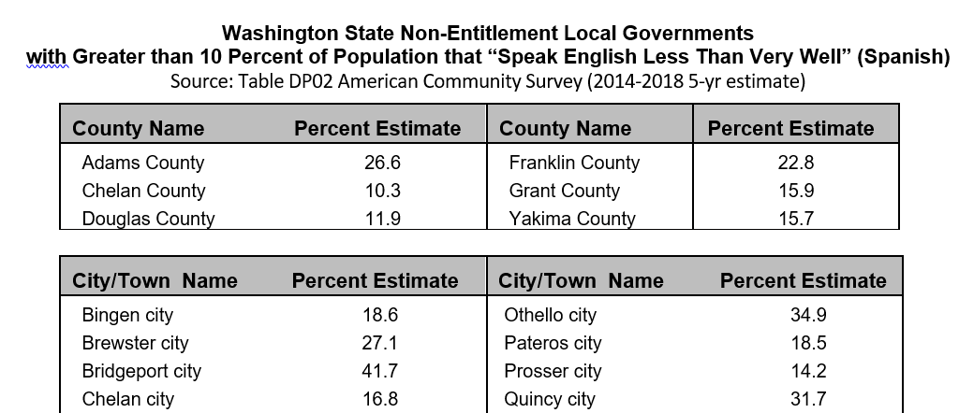
Citizen Participation & Demographics Tab Public Hearing Steps (Q1-Q20)
Local government must conduct a CDBG public hearing
Before due date = June 3, 2020
Advertised at least once, two weeks before hearing
Distribute CDBG handouts
Assess % of non-English speaking residents
See Citizen Participation Guide list
Consider project beneficiaries
If so, public hearing requires
special notice and interpreter
Notes:
Purpose to ensure citizen awareness and input on CDBG opportunity and potential impact
Citizen participation Guide and resources available in the Library Tab.
Must conduct at least one Public Hearing (not public meeting)
Must be held before June 3, 2020
Advertise two weeks before public hearing
Advertisements for same project good for 18 months (example if reapplying from last year)
Must distribute CDBG handouts and provide hearing minutes
Will need to determine if there is a significant # of non-English speaking residents in the community
If 10% or greater, public hearing requires special notice and translations
Citizen Participation Guide, page 2, provides list of local governments with greater than 10% of population that “Speak English Less Than Very Well” (Spanish)

Slide 33
Public Hearing Resources
Sample Public Hearing notice
Grievance Procedure
One already adopted for a previous CDBG?
Not ADA or personnel grievance procedure
CDBG Public Hearing handouts
CDBG Fact Sheet
Citizen Participation Requirements
English and Spanish versions available
Resources located
in Library Tab!
Notes:
Follow Citizen Participation Guide based on your assessment of residents
Coordinate hearing notice, required steps and documentation with clerk!
Advertisement
Notice can be posted on local government website IF it meets local public hearing notice requirements
The public notice MUST be published or posted at least two weeks before hearing date
Adopted and submit Grievance Procedure
Can use procedure adopted from previous project
Not an ADA or personnel grievance procedure
Conducting public hearing
Multiple handouts required, include:
CDBG Fact Sheet handouts (available in English p. 111 and Spanish on the CDBG website)
Citizen Participation Requirements
Grouped under Public Hearing Resource in the ZoomGrants Library Tab
THEN complete ZoomGrants questions and upload documentation.

Slide 34
Citizen Participation & Demographics Tab Demographics and Title VI (Q21-Q29)
(Q21-22) Report ethnicity/racial population %
(Q23-29) Report efforts to ensure project nondiscrimination
Instructions to Census data in Library Tab
Notes:
Purpose:
To ensure nondiscrimination in implementing CDBG project
To better understand community and local demographics
For reporting purposes
Step by step instructions for Ethnicity and Race Data collection in Library Tab

Slide 35
Citizen Participation & Demographics Tab Certifications of Compliance (Q30-31)
Sample and instructions in Library Tab
Insert project name and amount requested
Opt: Designate authorized representative for CDBG project
Sign and adopt as resolution
Scan and upload in ZoomGrants
Maintain original in applicant’s CDBG files
Notes:
Sample resolution and instructions in Library Tab
Insert project name and amount requested
Opt: Designate authorized representative for CDBG project
Sign and adopt as resolution. Can occur at same meeting as public hearing or later meeting after hearing comments considered.
Scan and upload in ZoomGrants
Maintain original in applicant’s CDBG files

Slide 36
Notes:
Get Video ready
During Break pull up CDBG GP Website
Log back into Jon’s ZoomGrants

Slide 37
Project Information Work Plans, Budgets & Narrative
Presentation Resource:
Narrative Instructions and Questions
Budget Instructions
ZoomGrants Application Print Preview
Remember - Application Documents are available at the ZoomGrants Library Tab & CDBG Website
Notes:
We are now going to take a look at the Project Information, Work Plan, Budget & Narrative Tab.
During this next section, it will be helpful for you to reference the following resource documents: the “Narrative Instructions and Questions”, the “Budget Instructions”, and the “ZoomGrants Application Print Preview”.

Slide 38
Project Contact Information
Applicant jurisdiction contact
Required identifying code #s
Project Location
If applicable:
Subrecipient contact
Consultant contact
Notes:
Within this Project Information, Work Plan, Budget and Narrative Tab, the TOP SECTION has 2 kinds of data. Applicant Information and Project Location data are REQUIRED.
The next sections cover Subrecipient and Consultant information, which are both OPTIONAL dependent upon the project type and partners.
This Tab’s “Instructions Button” gives guidance with some helpful links for items such as Setting Up a Statewide Vendor (SWV) Number, Finding a UBI Number, Checking for exclusions on the System for Award Management (Sam.gov) AND even a links to find Latitude & Longitude. Please note that the sam.gov is a FREE Government Service and you should not be asked to pay money to sign up for this.

Slide 39
Work Plans
Realistic project end date
Tell us what’s already in progress
Be specific, add lines and pages for more tasks
Work Plan supports Capacity and Readiness statements
Notes:
The next section of this Tab is where the Work Plans are listed. There are 3 Work Plan VERSIONS included within this ZoomGrants application tab.
The FIRST one is for construction & acquisition projects. The NEXT is one for local assistance programs, which includes tasks such as housing rehab with side connections or microenterprise programs. The LAST Work Plan listed is for Planning-only. Instructions for each type of Work Plan are located in the Library Tab.
Here we ask you to provide what has been done so far as well as the planned activities with timelines.
If your project is Phased, the Work Plan should also reflect additional tasks and workload such as construction procurement & labor standards. For these types of projects use the Supplemental Work Plan form in the Library Tab to provide this information; once it has been completed upload it to the Your Uploaded Documents Tab.
Consider environmental factors that might impact your project. This could apply if your project is in a floodplain or contains wetlands. Include any obstacles such as permitting or obtaining water rights that may cause significant delays.
We prefer forthcoming answers for any potential delays to get an accurate view of how ready to go your project really is and we do not want these grant funds sitting.
The Work Plan should also support and align with: the application Capacity and Readiness Narrative statements.

Slide 40
Budgets
Project Budget
Shows how CDBG funds will be used
Lists other fund sources and uses
Add lines if more costs
Must match Project Summary (Q7)
Operations Budget
Only required for community facilities and fire protection facilities
Notes:
Following the Work Plan section of this Tab is the Project Budget section. The Project Budget is REQUIRED for ALL Project Types.
If your CDBG project is part of a larger project, a CDBG program budget & also the budget for the larger project should be provided to show HOW the entire project will be funded. This is very important.
For example, if CDBG is being asked to fund: water to a new affordable housing project & we don’t see the budget for the whole project, we are unable to determine if the project is fully funded. In this case, if it is not fully funded, it cannot meet CDBG eligibility (even if the water infrastructure is in place, the houses would have to be built and occupied before it could meet the national objective to benefit the Low to Moderate Income persons).
We do want the primary focus of the application to be the CDBG funded element, but in any case where we are unsure of the whole picture, it may make an application less competitive. So in some cases, it may make sense to upload an additional budget for the non-CDBG funded project element.
The main goal is to provide enough of the relevant information so we are Confident YOUR PROJECT will meet the National Objective within the CDBG Project Timeframe.
If you have important budget activities to your project that are not listed, there is an Option to enter in “other” budget activities, at the bottom of the ZoomGrants Project Budget.
The Budget information needs to align with data entered in the Eligibility Summary Tab within the Project Summary Section under Question #7 - please reference the ZoomGrants Application Print Preview (page 2, near the bottom).
Please note: In Question #7, we are asking for the cumulative funds for any local, state, and federal project funding in your project, but in the Project Budget we want you to provide a breakdown of these amounts.
The Operations Budget is only required for community facilities and fire protection facility projects. This Form is located in the ZoomGrants Library Tab. Download load it from the Library Tab, complete it, and then upload it to Your Uploaded Documents Tab prior to application submittal.

Slide 41
Project Budget
Calculate totals by source and activity
General administration vs. project administration
What will CDBG actually pay for?
Must follow CDBG procurement requirements
Each expenditure must be tracked – keep simple
Notes:
Now let’s look at how the Project Budget is laid out.
First, Enter in the Source of Funds. If more than 4, Use the Supplemental Project Budget located in the Library Tab. Again, you will need to download the form, complete it and upload it to the Your Uploaded Documents Tab.
Next, identify if funding sources are committed by answering yes or no. If no, be sure to give a target date for when you will know.
As you tab through the budget fields entering amounts, the total fields will not be calculating. You must select the Refresh Button at the top of the web page in order for the amounts to total; both on the right far column and the bottom row.
As you break down costs by activity & funding source, make sure you consider which type of activities can be funded by which sources.
Include General Administration costs, EVEN IF CDBG will not be funding those costs; they count as in-kind. Guidance for General Administration and Project Administration costs are on located in the Budget Instructions (found in the Library Tab). Be sure to review the instructions to understand budget line definitions. Convince us budgets are sound and the project is sustainable.
We do understand the budget amounts are estimates at this time and may change a little. That is ok within budget categories, as long as it is not substantial.

Slide 42
Narrative Questions
Competitive process. We look for:
Financial need
Compelling need
Capacity to implement and maintain project
Feasible technical solution that is ready to proceed
Agreement (citizens, government, regulators)
Results are worth the public investment
Tell us your story
Document your statements
Notes:
Now what you may be most interested in is: “What are my chances of being awarded this grant funding?”
Well, this depends on a couple of things. As Kaaren mentioned, the Federal award is allocated to the state; using this we come up with our pot of available dollars, which is approximately $12M for this 2020 cycle.
The other main factor is: the Size of YOUR grant request & how others rate compared to YOUR application.
In 2019: 43 grant applications were received (a record high year); of those, 2% did not meet threshold. 66% of eligible applications were awarded funding.
Even though, we do speak with many of you prior to the application due date, keep in mind - most raters will know very little about your project.
The Narrative (excluding any supplemental Work Plans, Budgets, & Uploaded documents) must not to exceed 25 pages; we want it to be complete and concise!
Any questions now, before I begin going over each type of Narrative Section?

Slide 43
Narrative Questions
Project Description - Describe project and its components to give a clear view of what CDBG is being asked to fund.
Scope of work
Service area and project location map(s)
Utility system map/Floor plan
Budget for any other phases
Notes:
Need to Upload Narrative Instructions and Questions from Library Tab
Here answer: the What (not the Why)
Description:
What is CDBG paying for?
Components = EX. well upgrades, distribution lines, street improvements, telemetry…
Need Map(s) – service area, project location
IF multi-use community facility we need to see a floor plan with activity by square footage
If Phased project (included in Work Plan and budget(s)) – also describe big picture here
Upload Required Documentation – at bottom of each narrative section

Slide 44
Narrative Questions
Financial Review – Financial need and viability
Financial capacity / Need for level of CDBG grant
Funding secure or underway
Program income
Ongoing financial commitment
Notes:
Describe resources or funding secured or what local efforts to seek other funding has been made; Affordability Review - demonstrates need for grant funding
Program income
CDBG funds from a prior CDBG grant
Will you earn PI on this grant and how will you track it
Describe how community will support operations, maintenance and services for at least ten years
Tied to Budget Ex. Operations Budget
Other funding documentation
Budget Assumptions
Detail basis for numbers
Include administration and construction cost detail
Show how you’ve thought through all costs
Upload cost documentation

Slide 45
Narrative Questions
Need Statement – Need facing your community and the public prioritization process.
Relevant background info; local conditions
Impact, hardships, severity
Urgency
Description of public health and safety issue
How and why prioritized
Notes:
What is problem and/or opportunity? Why this project now?
Range of Need (from lower points to higher points):
Inconvenience vs public health issue
Inadequate water pressure vs collapsed well
Generally old housing stock vs have existing waiting list
Too small facility vs hardships resulting from lack of facility
Permit requirement vs regulatory order
Listed in a water system plan vs top priority on capital facility plan
Elected official’s favorite project vs documented broad community support
Opportunity: what momentum w/local partners could be lost w/o CDBG funding.
Ask: Compelling example of need and how would you document it?

Slide 46
Narrative Questions
Capacity Statement – Capacity to administer the grant.
Subrecipient?
Past effort – success so far and commitment
Project administration plan
Administration commitment
Corrective actions for recent audit findings (includes subrecipients)
Notes:
Subrecipient/Grantee relationship and oversight - past relationship; organizational experience Ex. small non-profit vs. special purpose district
POINT OF VIEW
Past effort: Tech team, rate increase, partnership building, planning, partnership building.
What has been accomplished to minimize or address the need?
How will you manage the project and keep it on track?
Open contracts? TIP - close contracts
Building Greenhouse Gas Emissions reduction into project is an opportunity strengthen capacity score
Status of open CDBG contracts

Slide 47
Narrative Questions
Readiness Statement – Best solution to the priority need and ready to proceed
Expands on project description
Alternatives considered – why best solution
Partners committed / regulatory agencies in agreement
Site control
Status of required plans, permits and environmental /cultural assessments
Obstacles mitigated
Notes:
Options considered
Preliminary design considerations
Results of consultation with partners
During system planning / value planning
Energy efficiencies
Disaster resilience
Timing factors / Work Plan
ER coordination EX. USDA/RD and other federal funders
Environmental mitigation (historic property, floodplain/wetland)
Weather constraints
Community events Ex. street construction and school opening
Plan approved, preliminary drawings
Site control Not required, but more competitive
WARNING: Tenants – follow the Uniform Relocation Assistance and Real Property Acquisition Policies Act (URA)
NEPA not required; can begin research, data collection and consultation. NEPA cannot be “complete.” Application triggers NEPA for entire project (non-CDBG funds too)
Obstacles / Plan to address obstacles
Remaining funds
Anything that may require design change

Slide 48
Narrative Questions
Results Statement – How project will address the need and benefit LMI persons, and results measurement.
Extent project addresses need
Benefit to low- and moderate-income persons
Direct and indirect effects on community
Why is project a good return of taxpayer investment
Notes:
Solves problem
Lost opportunity for points
Quantify data in pre and post table
Result identified in this sections but not as a need in the Need Section
How will services be improved or increased?
Net gain?
CDBG per household and impact?

Slide 49
Narrative Statements Completion
Complete all applicable Narrative Statements
Upload document to Your Uploaded Documents Tab
Answer Narrative Question after Narrative responses uploaded
All Steps Required for application submittal
Notes:
ZoomGrants APPLICATION PROCESS:
Go to Library Tab, Download document
Complete responses
Use results to Answer applicable Questions
Upload necessary Documents to Your Uploaded Documents Tab
Eligibility
Citizen Participation
Demographics & Title VI
Certification of Compliance
Narrative

Slide 50
In Closing…
Project and Application Development Tips
Remember - Application Documents are available at the ZoomGrants Library Tab & CDBG Website

Slide 51
Selection Process
Threshold review for eligibility
Issues may reduce Capacity narrative score
Rating and selection
Must receive at least 65 points
Highest ranking application from each priority project category receiving at least 65 points will be funded:
Sewer, water, transportation, community facilities, economic development, housing, and planning-only
Rating points up to 100:
Financial Review - 20
Need - 20
Capacity - 20
Readiness/Feasibility - 20
Results - 20
Notes:
More points is better

Slide 52
Chance of Funding
3 YR AVERAGES
Number of applications = 37
Number of awards = 23 (62%)
Non-planning projects
Number of applications = 29
Number of awards = 16 (55%)
Grant range = 189,000-750,000
Funds leveraged =
$1.7 other funds for each $1 CDBG

Slide 53
Project Development Tips
Project and Application Development Tips in Library Tab
Five tests to CDBG eligibility
Early partner consultation/citizen participation
(If rate-based system), determine your Affordability Index to assess and justify the level of request
Collect data and documents
to meet eligibility
to support narratives and budget
Plan for or begin NEPA environmental/cultural review
Notes:
Good CDBG fit?
Early Citizen Participation to build and document community support, find potential partnerships, improve project design
Affordability review to determine grant need level FOR RATE-BASED SYSTEMS ONLY. (Not Required with application)
New documentation requirements : 1) rate resolution or ordinance 2) the 2019 Schedule 09 (Liabilities)
Available in Excel at www.commerce.wa.gov/cdbg under Technical Assistance Resources to calculate AFFORDABILITY INDEX (2%?)
Data and documentation
Letters of support/commitment – from real stakeholders (Ex. community group, school district, funder, etc)
Regulatory agencies
Document # of instances for NEED
Relevant plan EXCERPTS
Early environmental considerations - floodplains/wetlands.
Where possible, avoid adverse impacts from occupancy and modification floodplain/wetland
Avoid development in a floodplain/wetland if there’s a feasible alternative

Slide 54
Application Common Omissions
LMI documentation not complete
Number of persons to benefit inconsistent
Budget amounts inconsistent
Public hearing notice less than two weeks before hearing date
Didn’t include required public hearing documentation
Hopefully ZoomGrants will minimize chance of missing documents!
The Instructions Button in the Your Uploaded Documents Tab provides a list and guidance
Notes:
LMI documentation not complete
Number of persons to benefit inconsistent
Budget amounts inconsistent
Public hearing notice less than two weeks before hearing date
Didn’t include required public hearing documentation
No application checklist, but ZoomGrant provides list of required documents
Either use 2 screens or print off instructions to review while you complete the ZoomGrants questions

Slide 55
ZoomGrants Application Tips
Review ZoomGrants instructions, Library and website resources
Won’t be able to submit until all required boxes are completed and required documents are uploaded
Don’t wait until the last day to upload documents and submit to allow time to resolve technical difficulties
Notes:
Become familiar with:
Tab Structure
Content
What is expected for Application Submittal
ZG’s won’t allow submittal w/out all required fields and document uploads
Start with due date and work back to be allow enough time
Chrome browser is recommended

Slide 56
Applicant Feedback Form
NEW Online Application
Feedback form located in ZoomGrants Library Tab
We need your input!
Notes:
Form not required for Submittal
Big changes – Working on Continuous Improvement
Helpful to get feedback

Slide 57
ZoomGrants Questions
Contact:
CDBG Content Related Questions Jacquie Andresen, CDBG Program Administrator jacquie.andresen@commerce.wa.gov (360) 725-3017
ZoomGrants Technical Questions Tech Support Desk Questions@ZoomGrants.com (866) 323-5404 ext. 2
Notes:
Contact information can also be found in 3 other locations:
On the CDBG General Purpose Website
In the resource document title: “Using ZG to Apply for CDBG GP Grants”, and
On the Program Information Tab labeled “Contact Admin”. This sends an email directly to me.

Slide 58
Year-Round Technical Assistance
On Infrastructure Assistance Coordinating Council website
http://www.infrafunding.wa.gov/techAssistance.html
Go to Technical Assistance web page
Select “Request Technical Assistance” button
Notes:
State Public Works Boards facilitating requests for technical assistance and tech teams through its website at IACC website at www.infrafunding.wa.gov under Infrastructure Technical Assistance

Slide 59
Questions
Other handouts, resources and staff contact information
www.commerce.wa.gov/cdbg
Notes:
Now we’ll open it up to questions. We are going to mute the audience and allow any of you who have questions to unmute your device. Staff are also available by phone or email to answer questions following the webinar.

Slide 60
Jacquie Andresen
Project Manager
Jacqie.Andresen@commerce.wa.gov
360.725.3017
Notes:
Thank you and….

